Slide 1
PROJECT REPORT
SATELLITE IMAGE ANALYSIS

Slide 2
ABSTRACT
Connected Component Analysis
Noise Filtering In Digital Image Processing

Slide 3
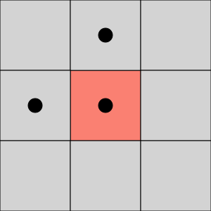
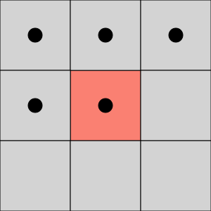
1 . Connected Component Analysis
Connected Component Analysis can be of two types
4 Connected Neighbour
8 Connected Neighbour
4 Connectivity
8 Connectivity

Slide 4

Algorithms
One component at a time: It is based on graph traversal methods. Starting from one pixel and propagating through its children.
Start from the first pixel in the image. Set current label to 1. Go to (2).
If this pixel is a foreground pixel and it is not already labeled, give it the current label and add it as the first element in a queue, then go to (3). If it is a background pixel or it was already labeled, then repeat (2) for the next pixel in the image.
Pop out an element from the queue, and look at its neighbors (based on any type of connectivity). If a neighbor is a foreground pixel and is not already labeled, give it the current label and add it to the queue. Repeat (3) until there are no more elements in the queue.
Go to (2) for the next pixel in the image and increment the current label by 1.

Slide 5
Two-pass:
Connectivity checks:
Does the pixel to the left (West) have the same value as the current pixel?
Yes – We are in the same region. Assign the same label to the current pixel
No – Check next condition
2. Do both pixels to the North and West of the current pixel have the same value as the current pixel but not the same label?
Yes – We know that the North and West pixels belong to the same region and must be merged. Assign the current pixel the minimum of the North and West labels, and record their equivalence relationship
No – Check next condition
3. Does the pixel to the left (West) have a different value and the one to the North the same value as the current pixel?
Yes – Assign the label of the North pixel to the current pixel
No – Check next condition
4. Do the pixel's North and West neighbors have different pixel values than the current pixel?
Yes – Create a new label id and assign it to the current pixel

Slide 6
Implementation:
On the first pass:
1. Iterate through each element of the data by column, then by row (Raster Scanning)
2. If the element is not the background
Get the neighboring elements of the current element
If there are no neighbors, uniquely label the current element and continue
Otherwise, find the neighbor with the smallest label and assign it to the current element
Store the equivalence between neighboring labels
On the second pass:
1. Iterate through each element of the data by column, then by row
2. If the element is not the background
Relabel the element with the lowest equivalent label

Slide 7
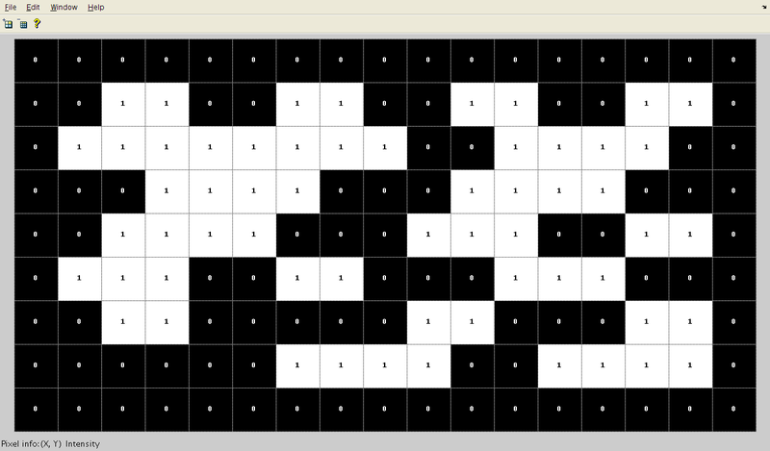

Slide 8
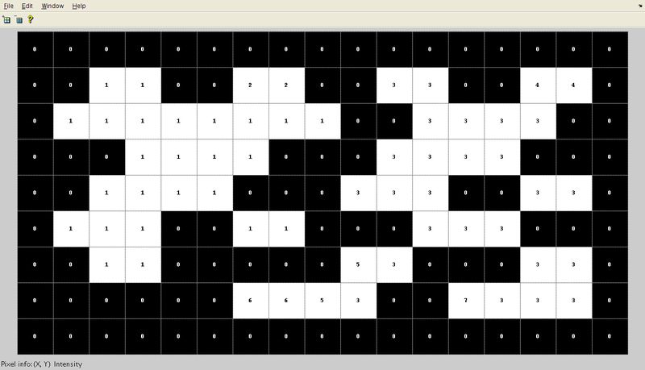

Slide 9
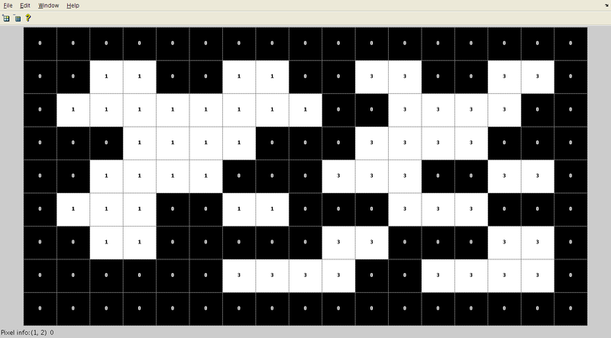

Slide 10
Noise filtering in Digital Image Processing
Noise is always presents in digital images during image acquisition, coding, transmission, and processing steps.
Filtering image data is a standard process used in almost every image processing system. Filters are used for this purpose. They remove noise from images by preserving the details of the same. The choice of filter depends on the filter behaviour and type of data.
Assumption:
The true value of pixels are similar to true value of pixels nearby
The noise is added to each pixel independently.

Slide 11
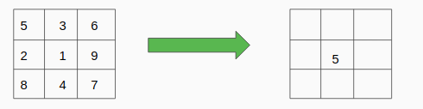
Types of Image noise filters:
Mean Filter:
Mean filter is a simple sliding window that replace the center value with the average of all pixel values in the window. The window or kernel is usually a square but it can be of any shape

Slide 12
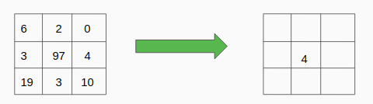
2. Median Filter:
Mean filter is a simple sliding window that replace the center value with the Median of all pixel values in the window. The window or kernel is usually a square but it can be of any shape.

Slide 13
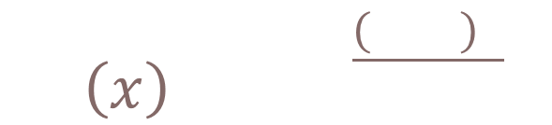
3. Gaussian Filter:
In image processing, a Gaussian blur (also known as Gaussian smoothing) is the result of blurring an image by a Gaussian . It is a widely used effect in graphics software, typically to reduce image noise and reduce detail.
4. Bilateral Filter
Bilateral filter uses Gaussian Filter but it has one more multiplicative component which is a function of pixel intensity difference. It ensures that only pixel intensity similar to that of the central pixel is included in computing the blurred intensity value. This filter preserves edges

Slide 14
THANK YOU

